Slide 1

Consumer Goods Analysis
Insights of sales pattern
Product variations
Quarterly report Analysis
Product Performance
By Sumitra Adhya

Slide 2
Problem Statement:
Atliq Hardwares (imaginary company) is one of the leading computer hardware producers in India and well expanded in other countries too.
The management noticed that, they do not get enough insights to make quick and smart data-informed decisions to expand their business effectively.
So, to understand the business better and see the future growth of company they want to get detailed insights that can help them to understand the potential of future business opportunities.
Let’s dive into the world of data to understand different products, their performance, variations, and much more.

Slide 3

Q1.Provide the list of markets , in which customer "Atliq Exclusive" operates its business in the APAC region.
Market
India
Indonesia
Japan
Philiphines
South Korea
Australia
Newzealand
Bangladesh

Slide 4
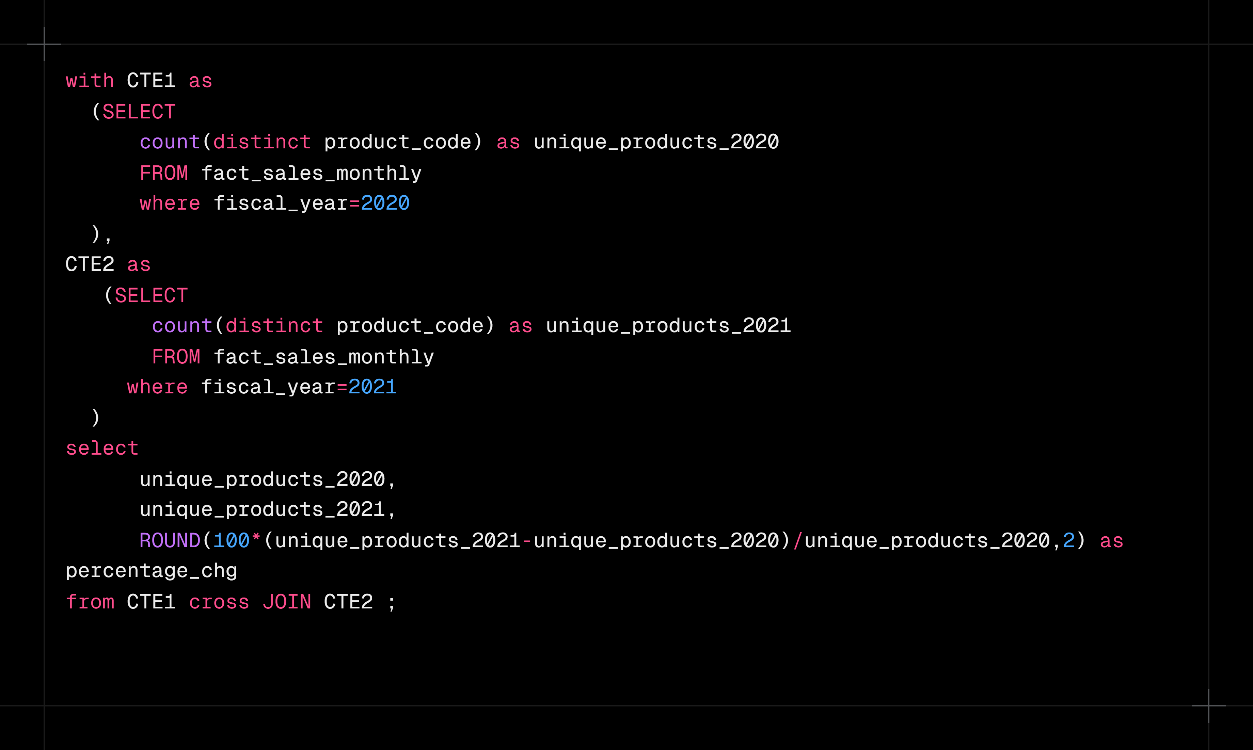
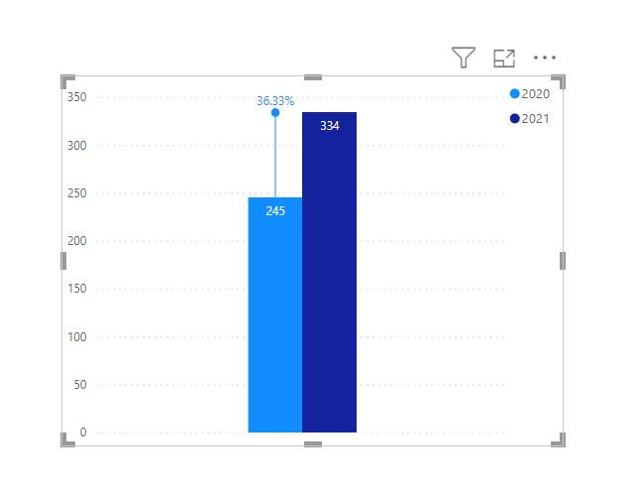
Q2.What is the percentage of unique product increase in 2021 vs. 2020?

Slide 5
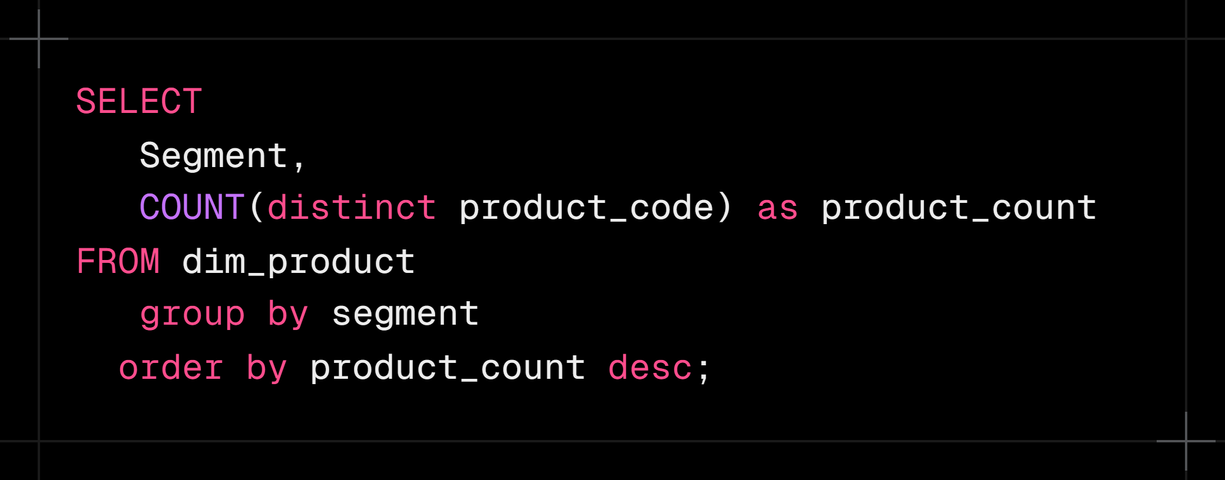
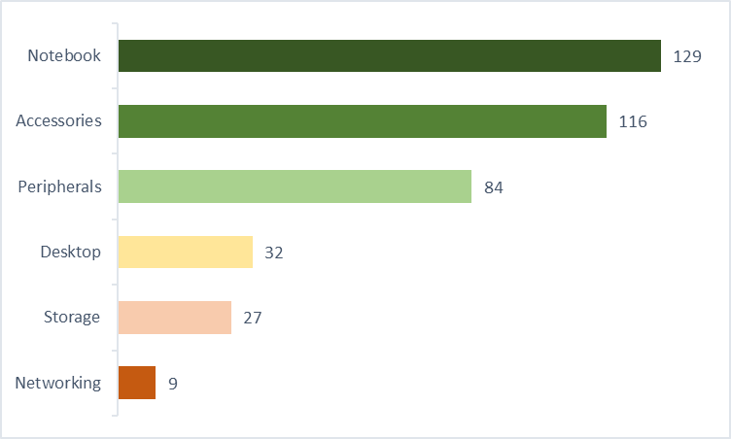
Q3. Provide a report with all the unique product counts for each segment and sort them in descending order of product counts.

Slide 6
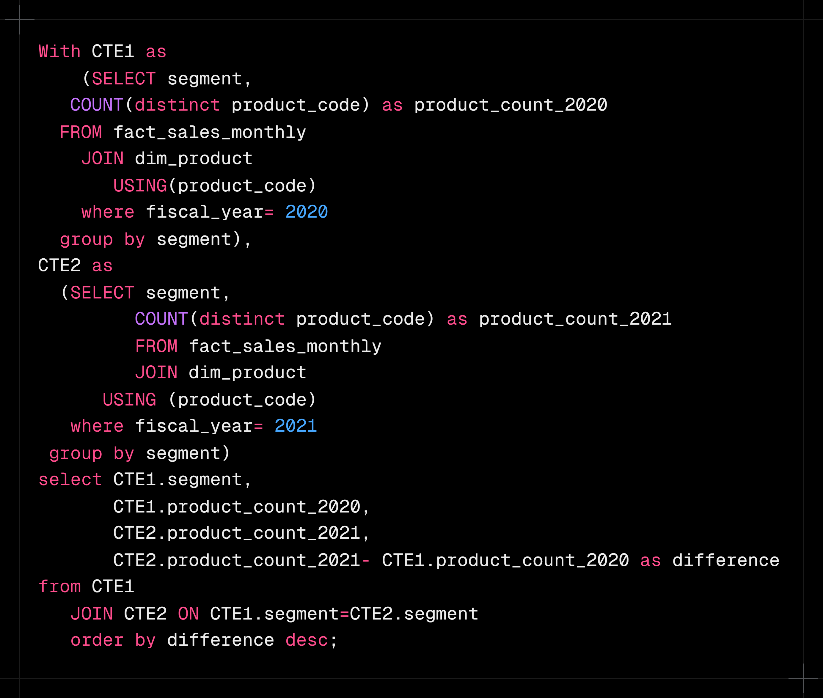
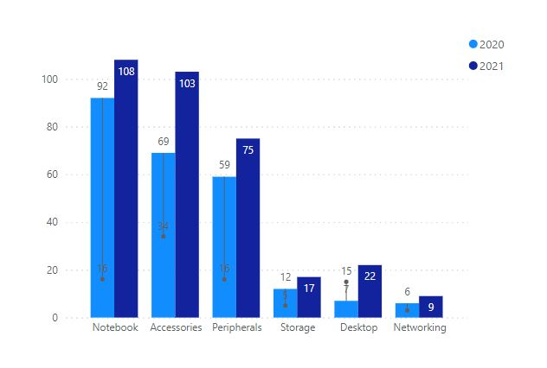
Q4. Follow-up: Which segment had the most increase in unique products in 2021 vs 2020?

Slide 7
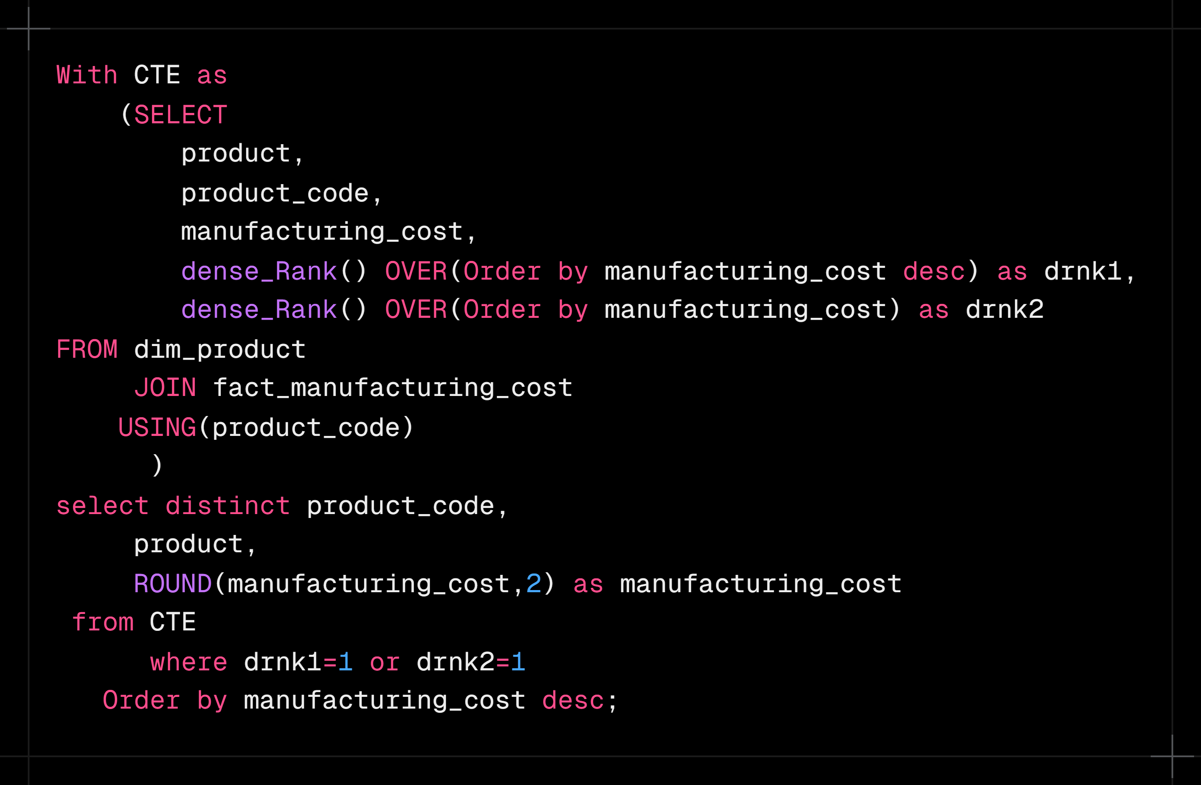
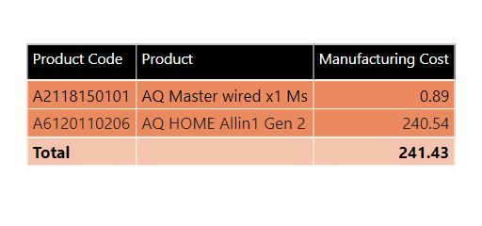
Q5. Get the products that have the highest and lowest manufacturing costs.

Slide 8
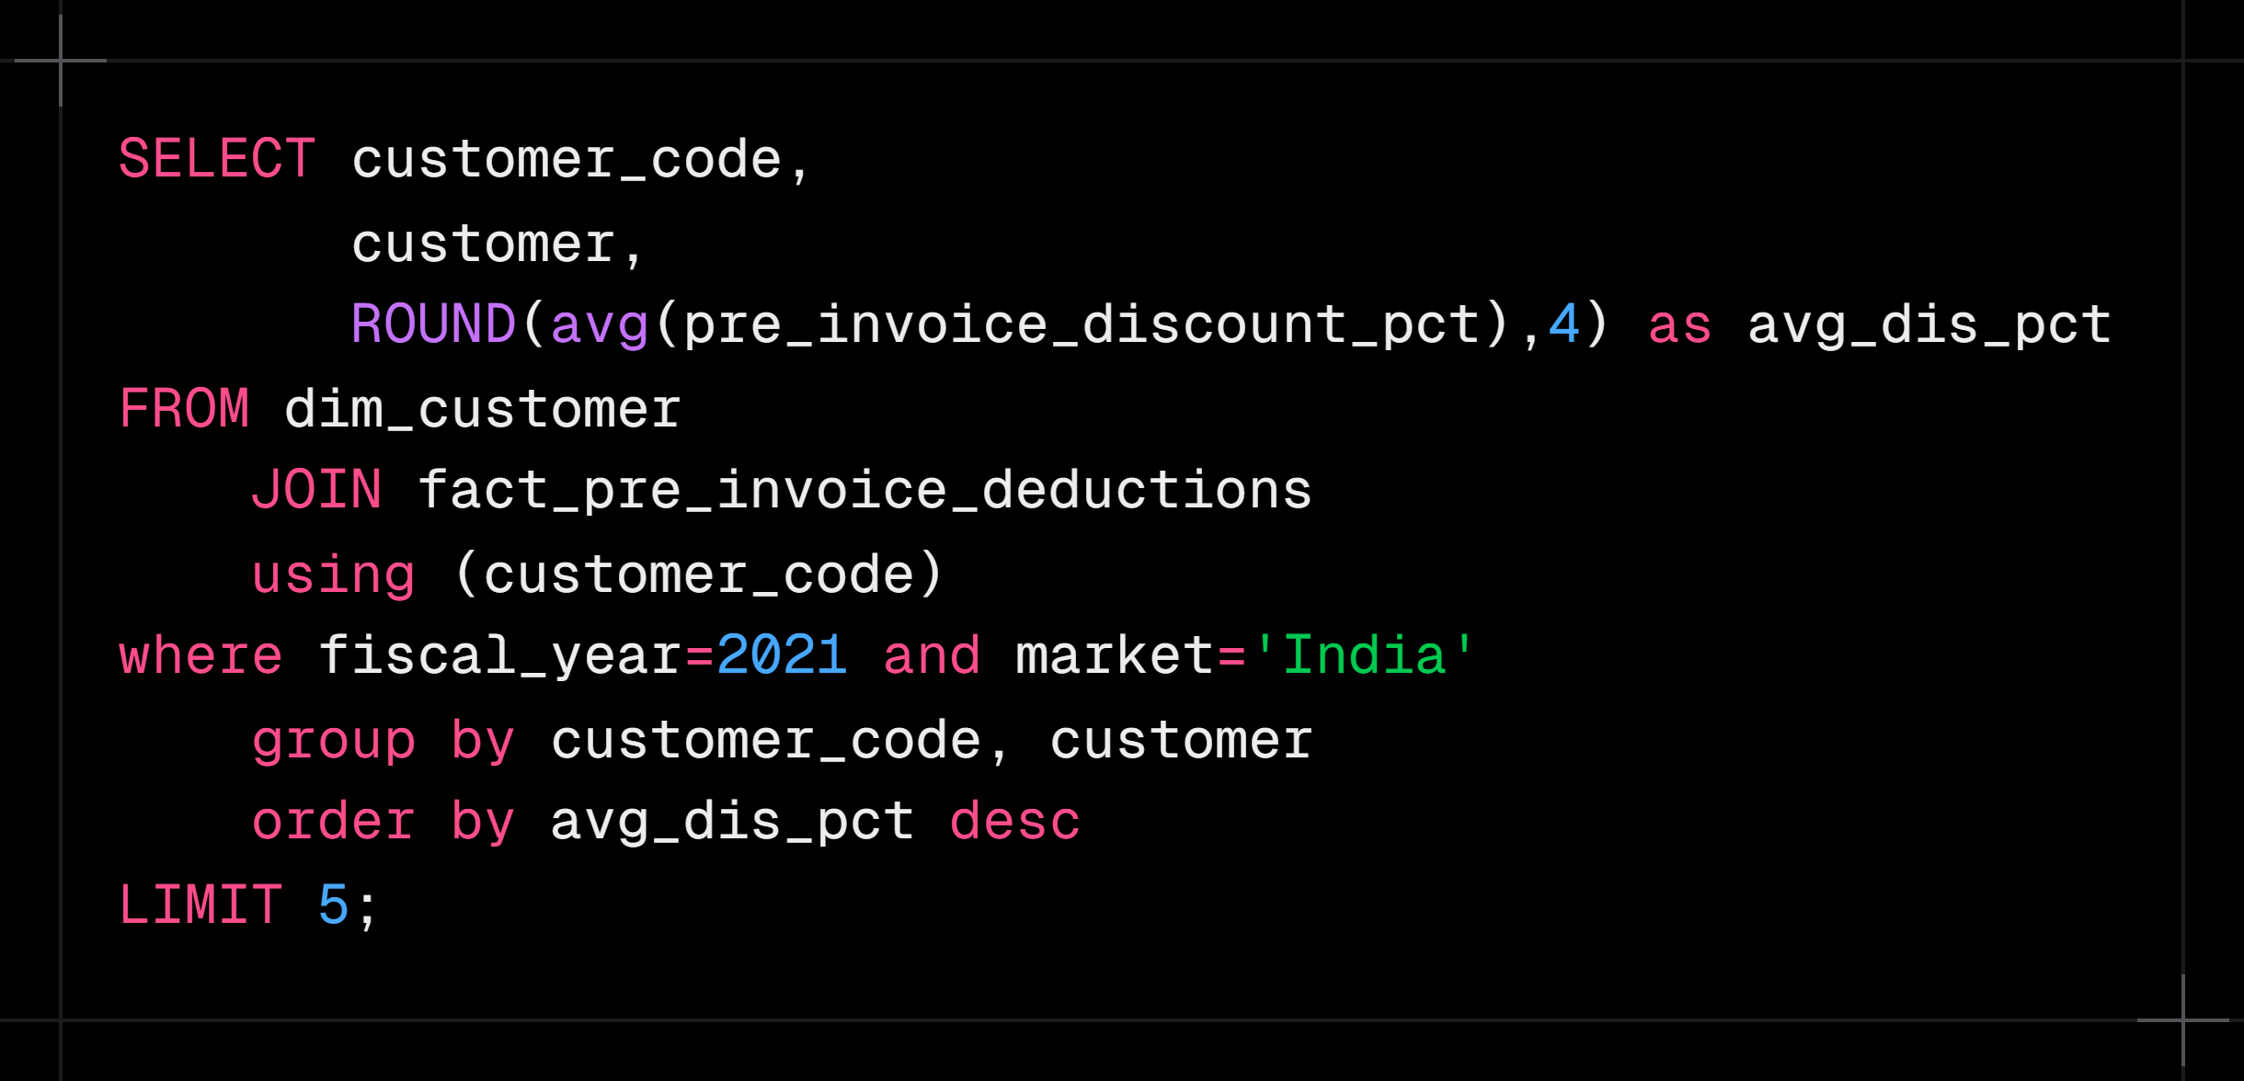
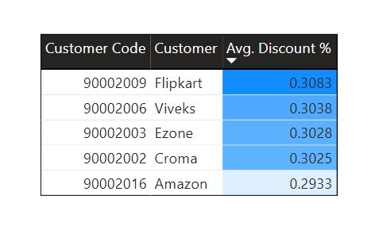
Q6.Generate a report which contains the top 5 customers who received an average high pre_invoice_discount_pct for the fiscal year 2021 and in the Indian market.

Slide 9
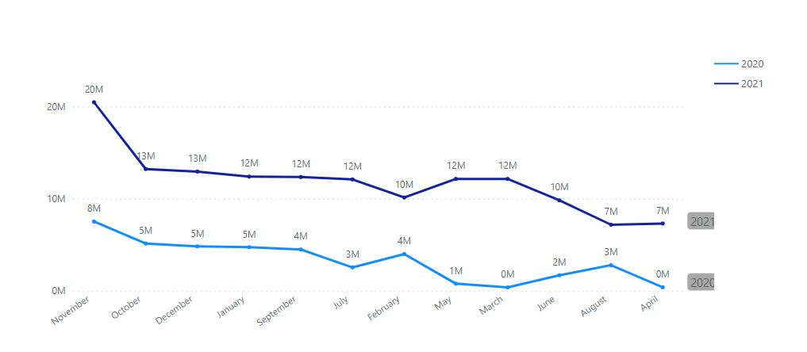
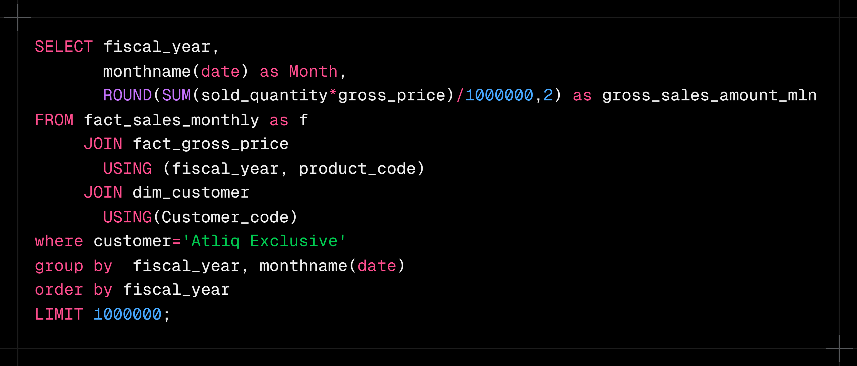
Q7.Get the complete report of the Gross sales amount for the customer “Atliq Exclusive” for each month .

Slide 10
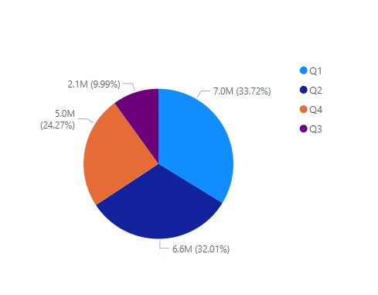
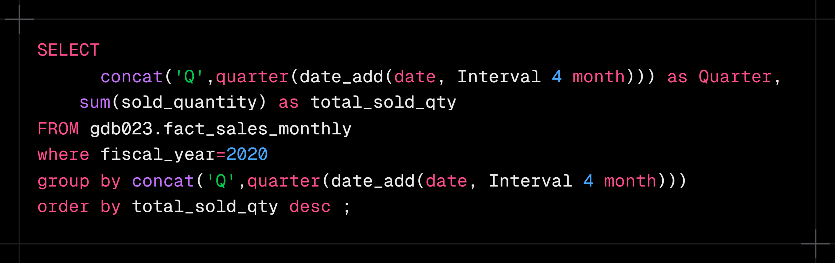
Q8.In which quarter of 2020, got the maximum total_sold_quantity? The final output contains these fields sorted by the total_sold_quantity,

Slide 11
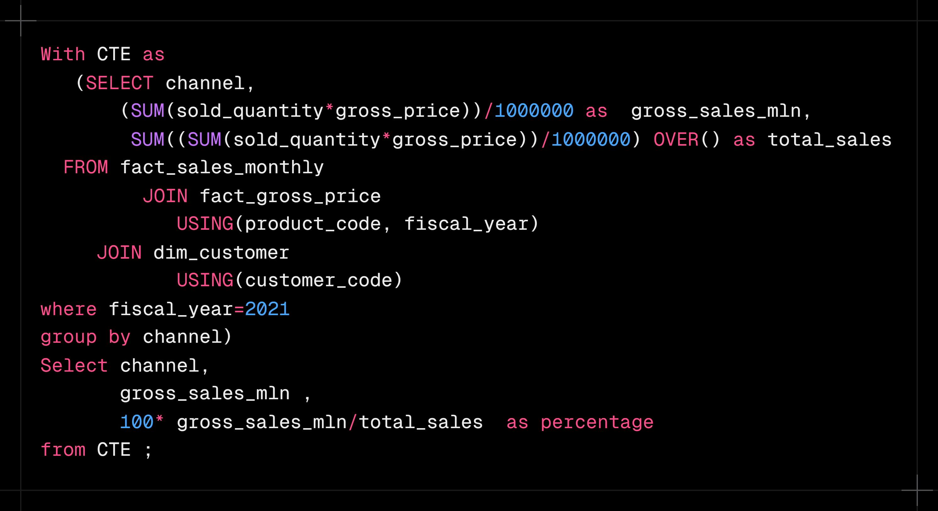
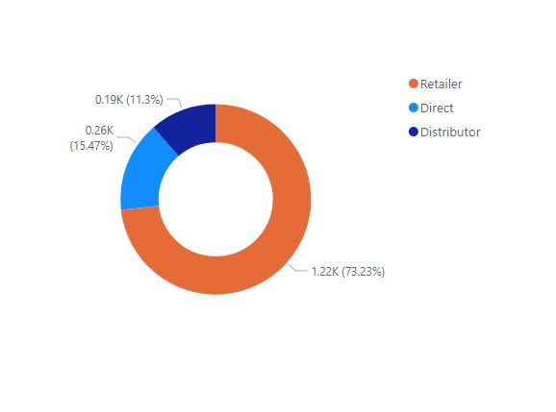
Q9.Which channel helped to bring more gross sales in the fiscal year 2021 and the percentage of contribution?

Slide 12
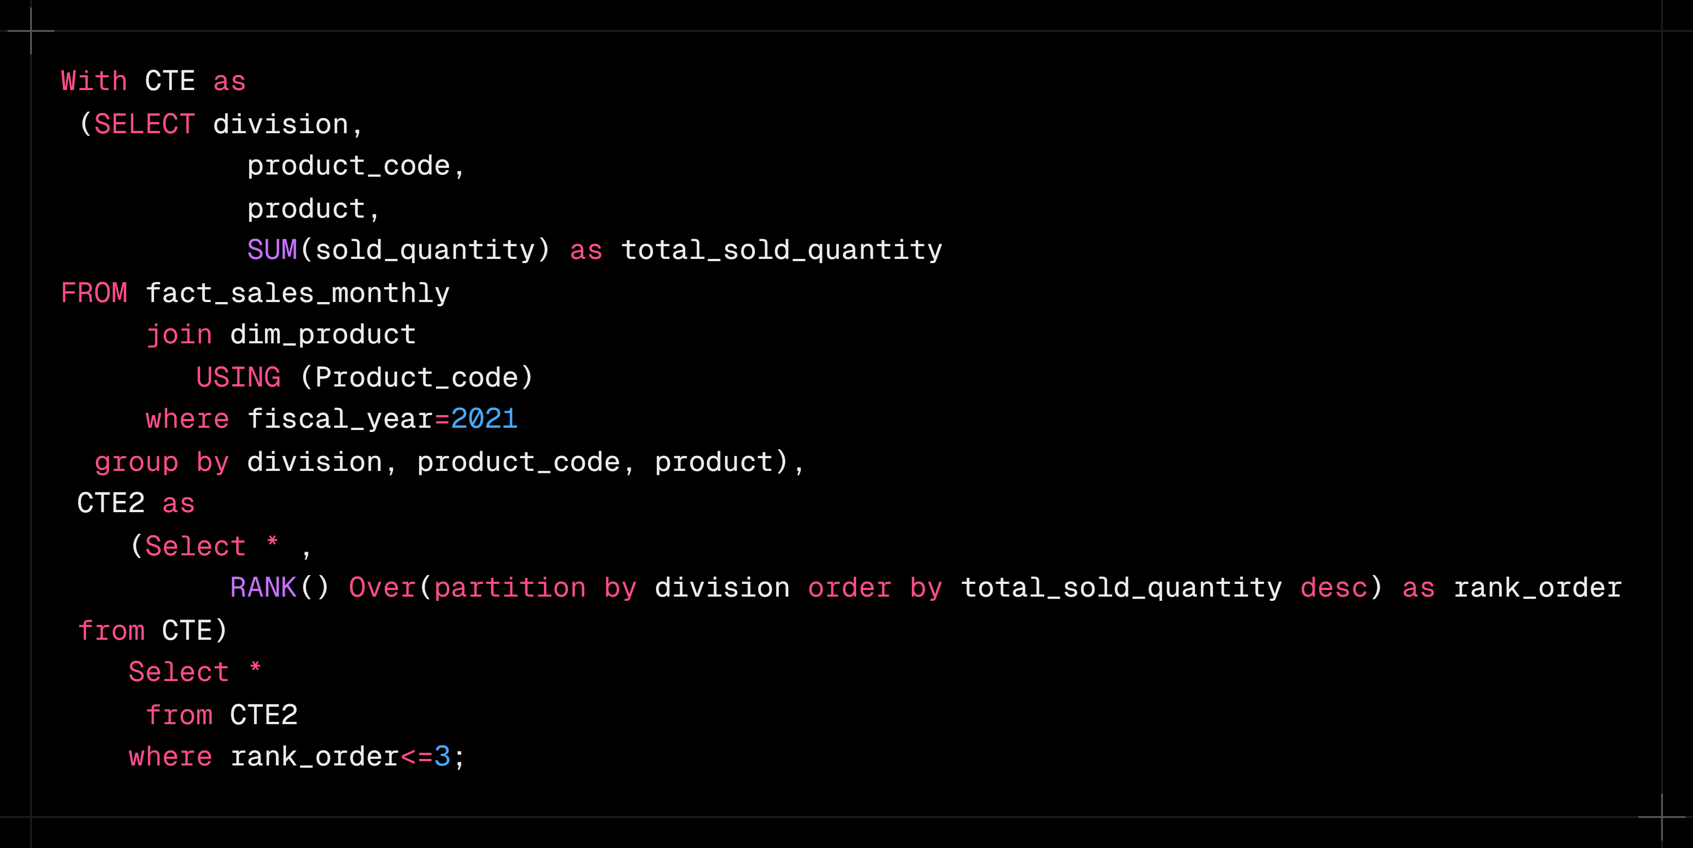
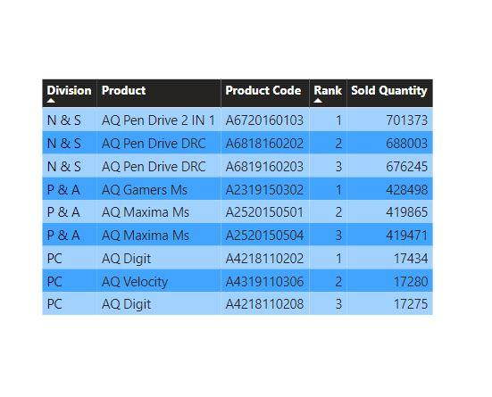
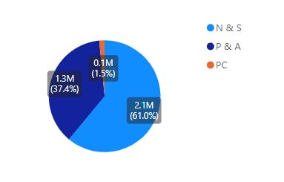
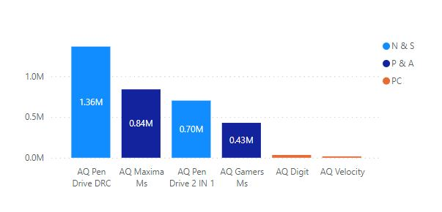
Q10. Get the Top 3 products in each division that have a high total_sold_quantity in the fiscal_year 2021?

Slide 13

Summary
Major sales going through retail stores.
Q1 and Q2 is the most sellable quarter. Festive season and holidays can be the most obvious reason.
Substantial growth has been observed between sales from year 2020 and 2021. COVID could be one reason why sales growth is low in 2020. 2021 December had been the top selling month in the year.

